Slide 1

DriverPass System Analysis
Jeremia Faust
Notes:
[No speaker notes required for this slide.]

Slide 2

System Requirements
Functional requirements
Access with any device
Validate user credentials
Nonfunctional requirements
Maintain and monitor security
Cloud services will backup data to provide not downtime
Notes:
The functional requirement of having access with the system from any online device will give the users the flexibility to asceses the system at anytime. This requirement was one of the system requirements so that the employee can maintain the system at any time and keep it current. To make this secure and to give the user their own account to maintain. Each user will have a login name and password that will be validated.
The nonfunctional requirements starts with maintaining and monitor security with will be done by the administrator. This is very important to catch problems that arise such as any data breaches. This will protect the company from any loss of data. The cloud service will maintain a live back up of the system on a separated system in the case of a critical failure. The system will have little to no downtime so there will be very little interruption to the system and to the company.

Slide 3
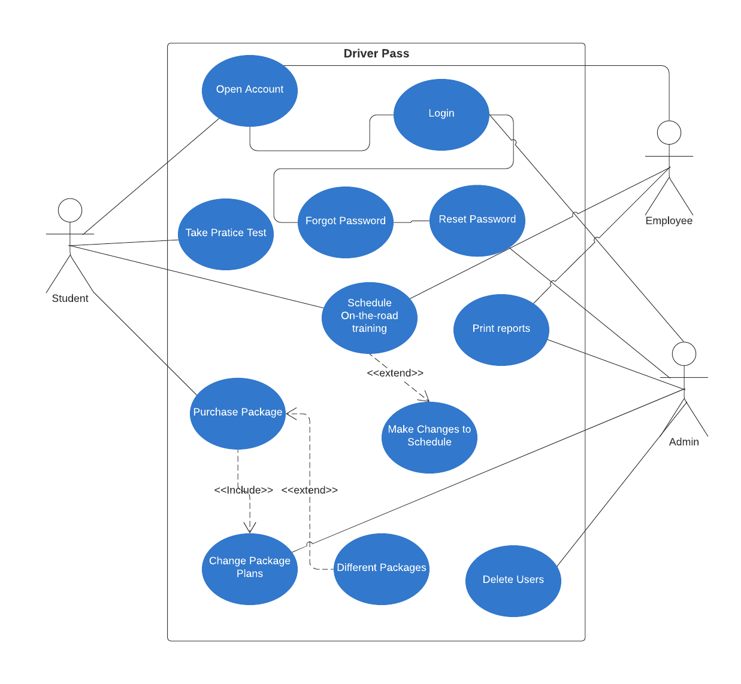
Use Case Diagram
Notes:
There are three different users to this system the student, the employees, and the administrator. Each user will be able to either open an account or login. If they forget the password each user can change their password. The admin also can reset a user's password or delete any user on the system. The admin will be able to adjust preprogrammed package plans for the student to purchase. Each user will be able to add/modify/delete the schedule for students. This will allow great flexibility to the system so no one person is bound to deal with all the scheduling. Of course, with this flexibility there is bound to be some conflict so there will be report generate that will allow the employee to monitor and see any problem that need to be addressed.

Slide 4
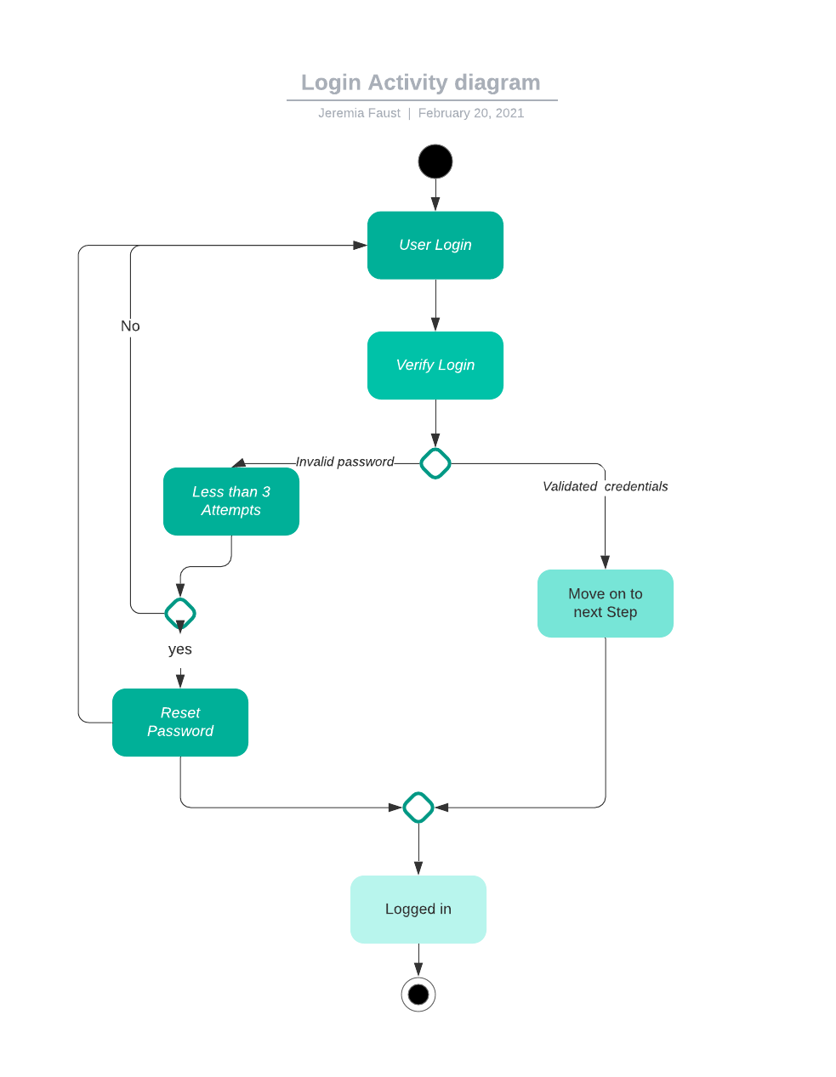
Activity Diagram
Notes:
This diagram shows what happens when a user logs in to the system. The user enters their credentials, it is then verified with the server. If the users entered the correct credentials, they now have access to the system. If they fail logging in 3 times, they are required to reset their password. This activity is very important to this system because it is the first step to the security of the system.

Slide 5
Security
User authentication
After 3 failed attempt users account will lock
Secure connection to servers
Defined user roles
Notes:
With any system that maintains data security must be on the forefront of every step in the process. With this system it starts with the user log in and password. If they fail the password challenge three times the user will lock. They will then have to reset their password. Once the user credentials are validated, they are logged in using a secure connect to the cloud server. This secure connect will protect the data that is being exchanged between the user and the server. There will be defined role of student, employee and admin that will limit access to the system depending on your role. The admin will be the only user with complete access to the system and they are charged to maintaining and monitoring the system.

Slide 6
System Limitations
No budget was given
Five month to complete system with limited staff
limited to specifications provide by the cloud company
Notes:
It was decided early that we wanted to use cloud technology to limited the need to having to maintain servers inhouse. That same benefit is also a limitation because we are limited to the specifications of the cloud service. There was no budget given so that may affect the scope of the system and the five-month timeline. That is a very quick timeline for the limited staff that we have available. Pending on the budget available we may have to onboard a few more staff to maintain the timeline.

